Slide 1
Paper Discussion
Third (& FINAL) Draft Requirements

Slide 2
Stephen Kings’ 4 Tips for Writers
Get It Out
!!!
Fix The Big Stuff
Does it flow?
Is it concise?
Does it make sense?
Tweak The Little Stuff
Fix Grammatical Errors
Revise Reference Section
Print It Out, Read It Aloud, Edit Again
!!!!
Notes:
The first three tips correspond to each of the three drafts.
Draft 1: Just Get it Out!!!
Draft 2: Fix the Big Stuff
Draft 3: Fix the Little Stuff

Slide 3
Required APA Formatting
APA-Format (Title Page, Body, References)
12 point Times New Roman Font
1” Margins
Please include your title at the top of first page of the body of your paper
Please include Author’s Note with contact information on the title page.

Slide 4
Required APA Formatting
The Purdue OWL: APA Style
https://owl.english.purdue.edu/owl/section/2/10/
Search “APA Format Primer”
Title page
Main Body
References
Notes:
No Abstract!! No Table of Contents!!
Rules related to section headers, in-text citations, reference section, quotes can be found at https://owl.english.purdue.edu/owl/section/2/10/

Slide 5
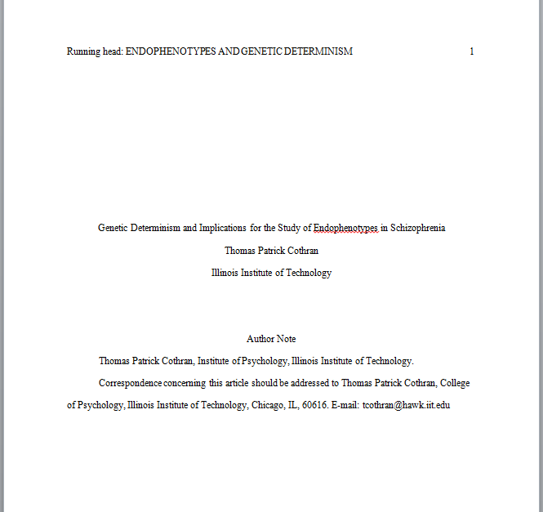
Title Page

Slide 6
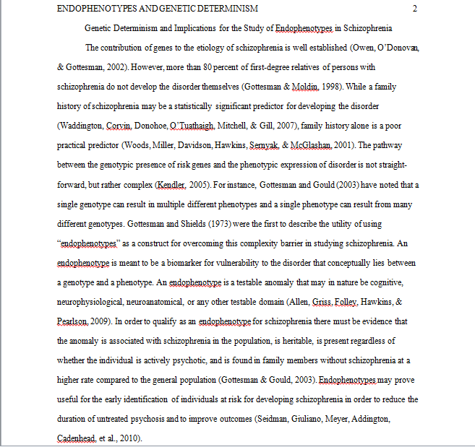

Slide 7
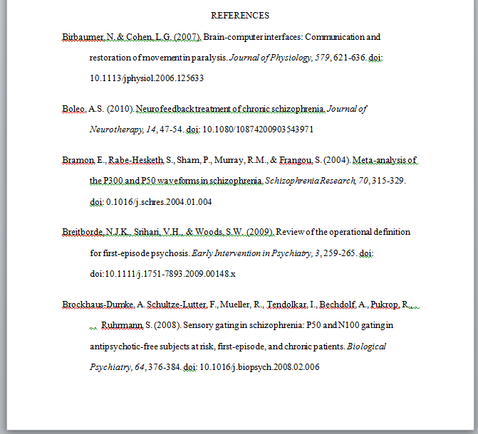
References
Notes:
Running head and page number were clipped in this picture, but are still included at the type. That part of the formatting has NOT changed compared to the main body.

Slide 8
Required APA Formatting
Potential APA-Formatting Errors
Title Page
Reference Section
In-text Citations
These errors will incur a 2% deduction EACH

Slide 9
References
doi numbers:
Alin, M. & Murray, R. (2002). Schizophrenia: A neurodevelopmental or neurodegenerative disorder? Current Opinion in Psychiatry, 15, 9-15. doi: 10.1097/00001504-200201000-00003
Doi numbers can often be found on the first page of an article published within the last 10 years.
crossref.org
Missing doi or retrieval URL?
-2 Points each
Notes:
doi = digital object identifier

Slide 10
Requirements
3rd Person Perspective ONLY
-2 point for EACH you, we, I, me, our, etc…
Grammatical and spelling errors = 2% Deduction Each
Notes:
One time I allowed the use of “we” → Humans
Danger of making generalizations with the words “you” or “we”
Implicit use of “I”

Slide 11
Requirements
Sentences >24 words will result in a 4% deduction EACH.
24 words = A-Okay
25 words = DOOM

Slide 12
Due Date
4/22 @ 10:00pm
Friday before the last week of class
Two weeks before Finals
William James Extra Credit also due 4/22 @ 10:00pm

Slide 13
Resources
IIT Writing Center
http://www.iit.edu/cac/student_resources/general/iit_writing_center.shtml
Siegel Hall, Rooms 232-233
Academic Resource Center
http://web.iit.edu/arc
Hermann Hall, 1st Floor, Northwest Corner HH-115

